Slide 1

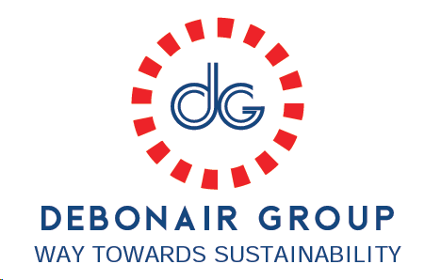
Debonair Business Summary with TNF & New Price Structure for S25 onwards

Slide 2
Price structure comparison:
Season | Profit % (%) | Finance Fee | TCE ($/hour) | OH (%)
F23 TNF | 8.00% | 5.00% | $2.91 | 8%
S24 TNF | 7.00% | 3.00% | $2.91 | 8%
F24 TNF | 7.00% | 3.00% | $1.04 | 200%
VF Standard | 7.00% | 2.00% | $1.07 | 192%
Debonair New Alignment for S25 to onwards | Aligned | Aligned | $1.02 | 190%
Eff (%)
28%
31%
33%
60%
45%
LOH rate ($/min)
-
$0.17
$0.16
$0.09
$0.11
Freight Cost | Earlier | New Aligned
Woven | $0.10 to $0.15 | $0.07
Knit | $0.25 | $0.18
Flecce | $0.40 | $0.25
Debonair also aligned freight cost for S25 to onwards seasons, where brand asking to decrease 9% but Debonair deducted more than 9%.

Slide 3
Example of some styles FOB by applied new Price structure:
Style | F23 FOB | S24 FOB | F24 FOB | Debonair New Alignment FOB | Difference | FOB Decreased %
A853L/A8BCJ | $41.69 | $40.73 | $41.34 | $36.62 | $5.07 | 12.16%
A83QX | $29.75 | $28.86 | - | $23.38 | $6.37 | 21.42%
A852U/A87CT | $28.54 | $27.36 | - | $23.86 | $4.68 | 16.40%
A83QY | $29.51 | - | - | $23.42 | $6.09 | 20.64%
A852M | $69.10 | - | - | $58.33 | $10.78 | 15.60%
A8329 | $29.72 | - | - | $23.62 | $6.10 | 20.54%
A3LH4 | - | $38.63 | $35.95 | $31.96 | $6.67 | 17.27%
A3LH5 | - | $35.40 | $32.77 | $28.95 | $6.45 | 18.21%
A8711 | - | $21.34 | - | $18.19 | $3.15 | 14.75%
A8710 | - | $21.53 | - | $18.38 | $3.15 | 14.61%
A88Y4 | - | - | $28.04 | $24.67 | $3.37 | 12.03%
A88ZA | - | - | $27.41 | $23.99 | $3.42 | 12.48%
 |  |  |  | Avg. | $5.44 | 16.34%

Slide 4
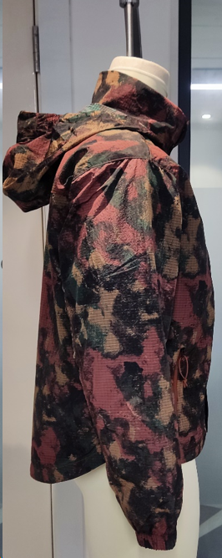
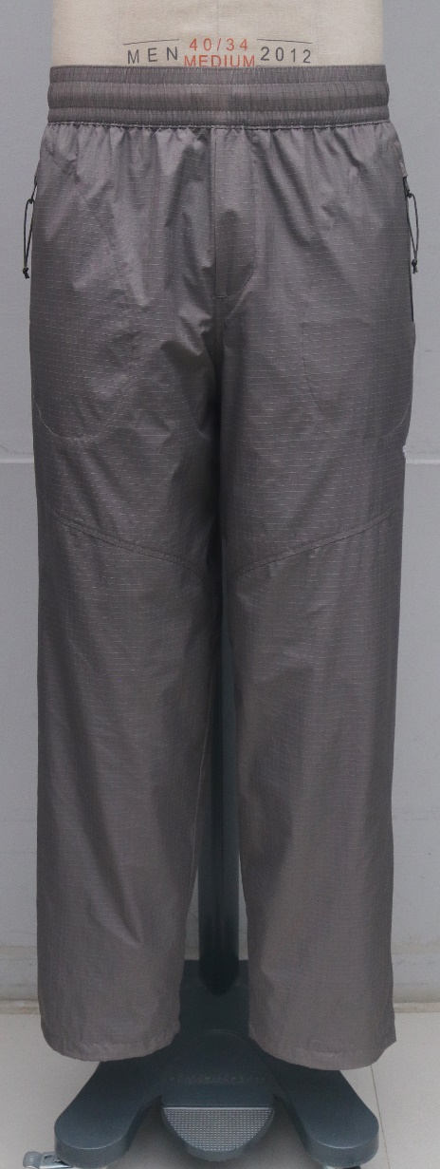
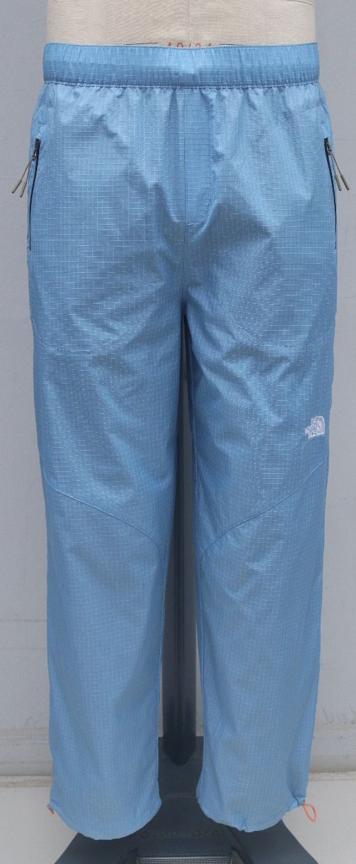
Earlier Dropped styles quoted FOB & now offer FOB by applied new
Price structure:
Style | F23 FOB | S24 FOB | Debonair New Alignment FOB | Difference | FOB Decreased %
A8321 (WIND JACKET) | $30.11 | - | $23.99 | $6.12 | 20.33%
A870E (WIND PANT) | - | $37.68 | $34.67 | $3.01 | 7.98%
A871K (WIND PANT) | - | $34.48 | $31.55 | $2.93 | 8.50%
 |  |  | Avg. | $4.02 | 12.27%

Slide 5
TNF F23 business summary with Debonair
Stage | Qty | Remarks
No of development styles | 7 | All development samples has been delivered on time
No of SMS styles | 7 | 391 pcs all SMS qty has been delivered on time
No of confirmed styles | 6 | The hit percentage from development to confirmed style is 85.72% but we didn’t received bulk order for one style.
No of dropped styles | 0
Total Order qty: | 50779 | Full qty shipped with 100% OTP. There were no quality concerns & 100% final inspection passed by self & 3rd party together.
Total FOB (Value) | $1,721,378 | "One million seven hundred twenty-one thousand three hundred seventy-eight dollars"

Slide 6
TNF S24 business summary with Debonair
Stage | Qty | Remarks
No of new develop styles | 12 | All development samples has been delivered on time
No of c/o styles | 4
No of SMS styles | 11 | 639 pcs all SMS qty has been delivered on time
No of confirmed styles | 14 | The hit percentage from development to confirmed style is 83.33%
No of dropped styles | 2 | There were 2 styles dropped after Proto 1
Total Order qty: | 120794 | Already 1,18686 pcs shipped on time & 100% final inspection pass by self & 3rd party together. Balance 2108 pcs will be shipped as per CRD
Total FOB | $2,967,312 | ''Two million nine hundred sixty-seven thousand three hundred eleven dollars"

Slide 7
TNF F24 business summary with Debonair
Stage | Qty | Remarks
No of new develop styles | 4 | All development samples has been delivered on time
No of c/o styles | 3
No of SMS styles | 4 | 184 pcs all SMS qty has been delivered on time
No of confirmed styles | 6 | Still the hit percentage from development to confirmed style is 75%, Since we didn’t received bulk order for one style.
No of dropped styles | 0 | But two styles has dropped before P1 stage/allocation
Total Order qty: | 50563 | Up to Feb'24 buy but we have another 8K projection qty for March buy of F24.
Total FOB | $1,763,773 | "One million seven hundred sixty-three thousand seven hundred seventy-three dollars"

Slide 8
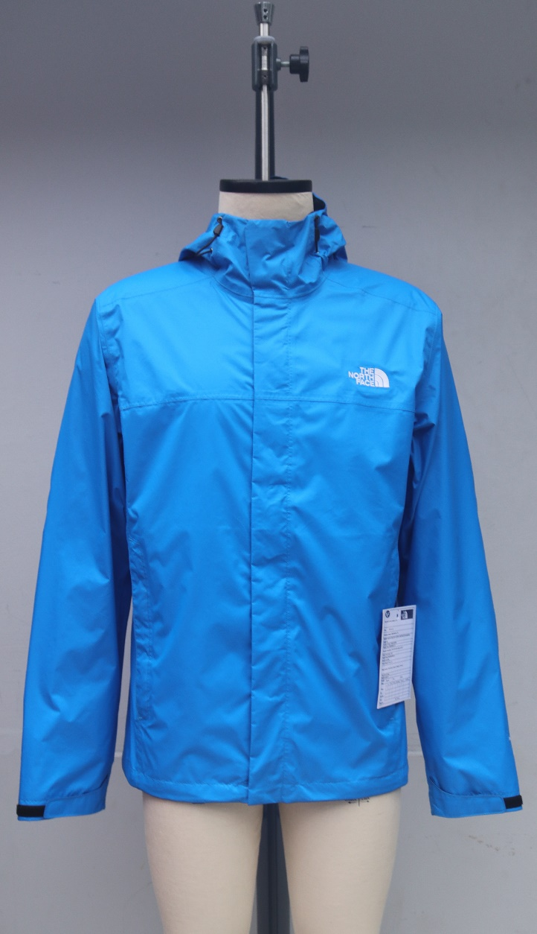
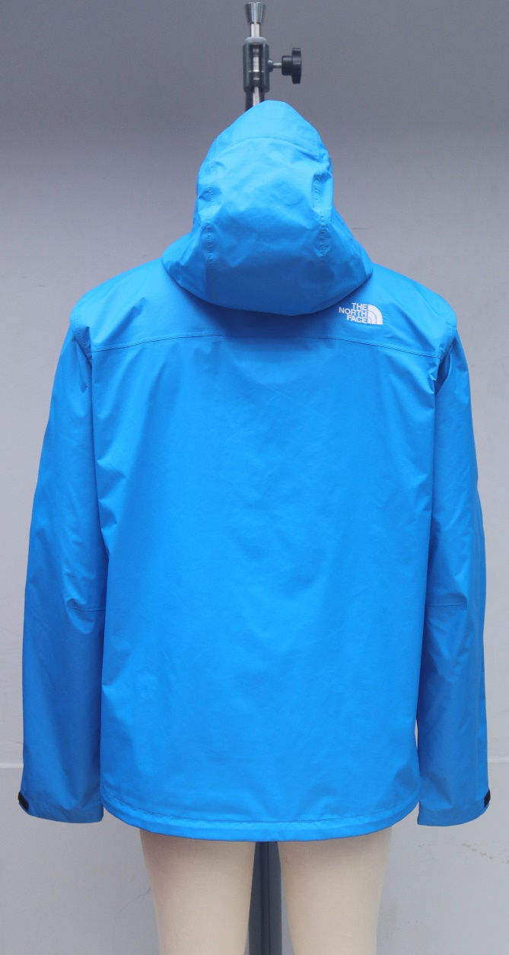
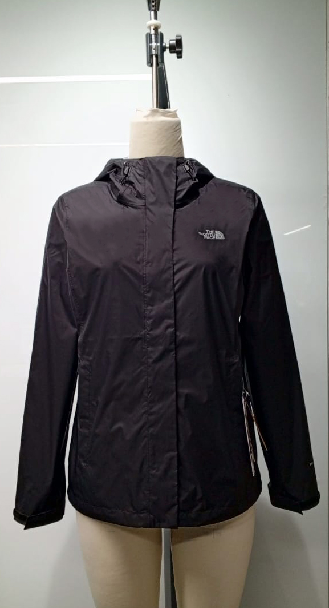
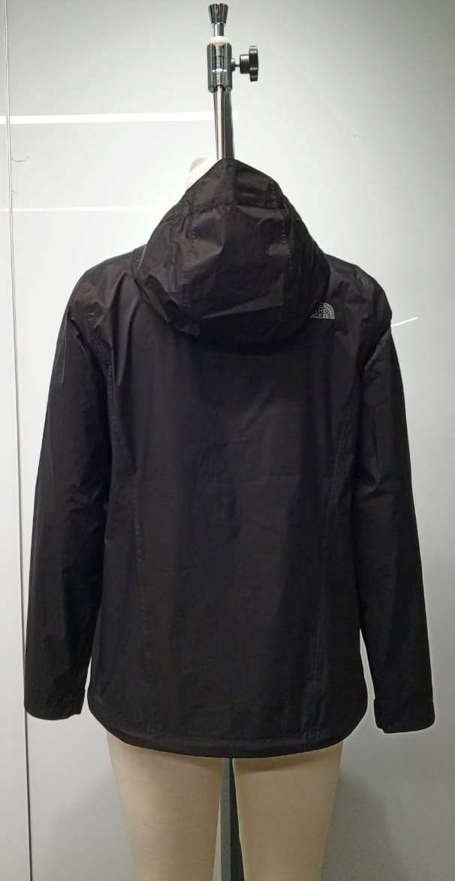
TNF S25 Projection with Debonair as per Jan buy plan
Stage | Qty | Remarks
No of new develop styles | 0
No of c/o styles | 2
Projection qty | 16525
Total FOB (Assumption) | $569,001

Slide 9
Debonair Overall business with TNF
F23: FOB $ 1.72 M / 0.051 M units
S24: FOB $ 2.97 M/ 0.121 M Units
F24: FOB $ 1.76 M/ 0.051 M Units (Till Feb’24 buy)
S25: FOB $ 0.57 M/ 0.017 M Units (Projection)
Overall total business value around $ 6.5 milions by 0.22 milions units

Slide 10
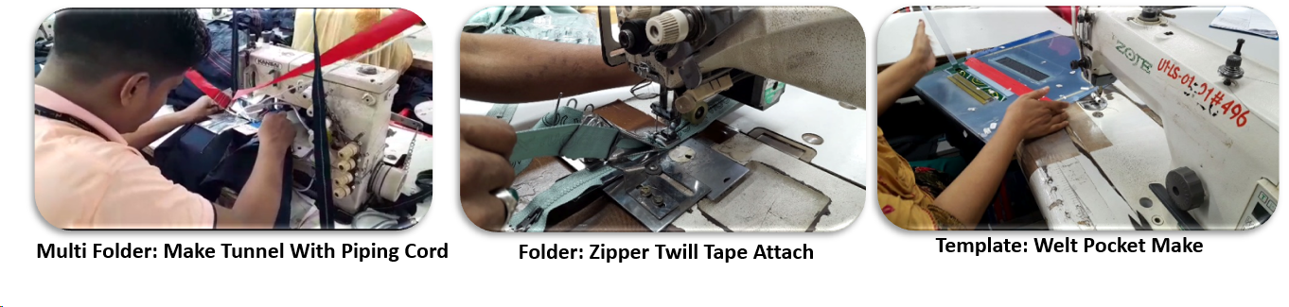
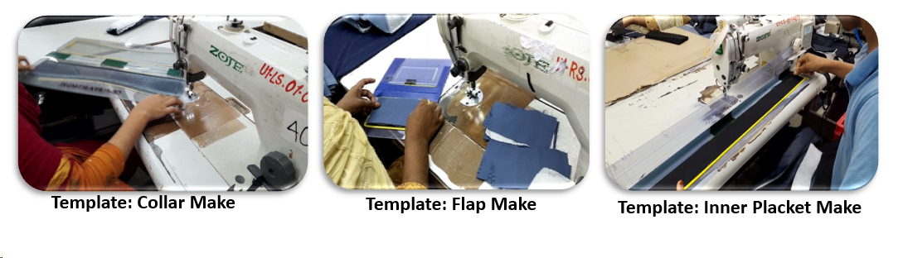
Debonair has build dedicated teams for TNF
Have a strong, dedicated Merchandising team who ensure on time support with higher standards as per brand expectation.
We have dedicated CAD & Sampling team along with CFT & QC for TNF. Also bought all required TNF mannequins for smooth working.
Have TNF experience/expertise in Production & Quality personnel in each department (Like Store, Cutting, Template, Sewing, Finishing etc.)
Debonair’s In house Lab is already accredited by VF Asia’s for all brands.
Potential confidence:
Now, our entire team is more expert to handle the all procedure accurately & efficiently.
Team are more proactive to execute and deal the brands expectations in terms of all points.
Continuous improvement is ongoing:
Debonair continues to work to close the gaps in SMV by automation & innovation facilities.
Team are also working continuously to improve factory efficiency level through sustainable development & arranging all required training to increase the skills also continuing the innovations.

Slide 11
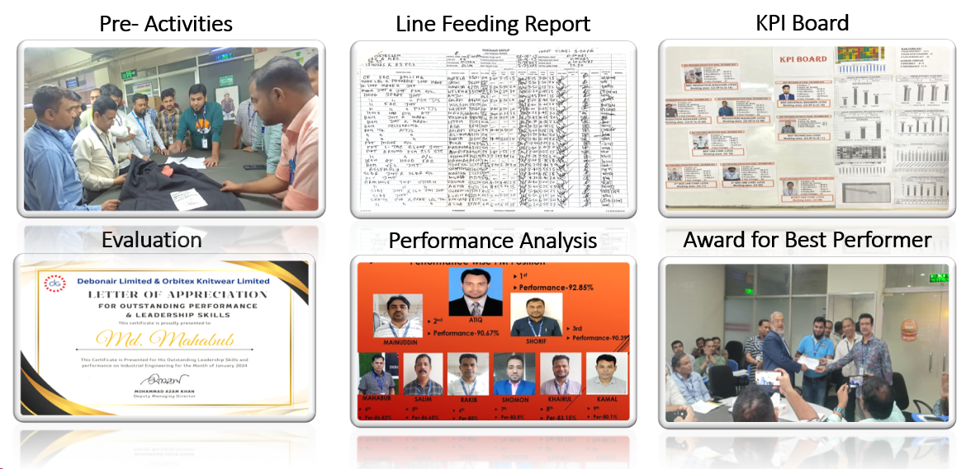
Efficiency Improvement plan
Debonair already started some initiative for improving the production efficiency:
3P meeting (Pre-activities done before layout)
Smooth Line Feeding (Quick Changeover)
Learning Curve incentive & Production bonus
NPT tracker to reduce NPT
Workload analysis & Smooth Balance sewing line
Awareness operator about quality, production and efficiency
Skill matrix maintaining
Bottleneck analysis & solution
Kaizen
Evaluation KPI & Certified them
Appreciation Award for best performer
Learning curve achievement policy
Feeding performance analysis
Training for operator and supervisor
Training for critical process

Slide 12
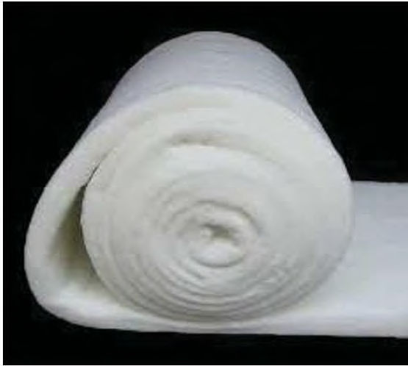
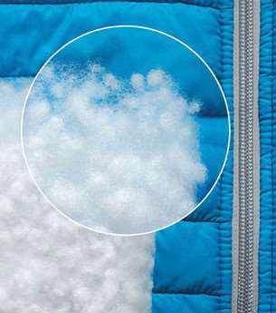
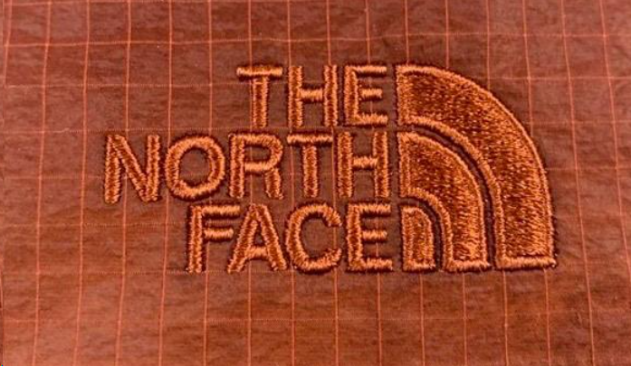

Debonair own items are utilized for VF Asia’s brand:
Debonair Padding & Quilting Solution Limited
A key success of Debonair: Our own insulations item (Synthetic down & padding) are now worldwide nominated for Timberland Brands.
Also Vans, Dickies & Supreme are using our own insulations.
Debonair has own Embroidery & Printing facilities through Shine Embroidery Printing & Packaging Limited:
Shine Embroidery is already proficient in various types of embroidery such as Regular Stitch, Sequin , Applique, Chenille, Tapping, Cording, Boring which are utilized for all brands like TNF, Timberland, Napapijri, Vans, Dickies and Supreme also.
Shine Printing section is already doing different types of printing like Rubber, Sticker, Pigment, Puff, High density, Flock, Photo Print, Discharge, Allover etc. for VF Asia’s brands.
Also have own manufacturing facilities of Elastic, Rib, Lycra binding, Twill tape etc. which are using for different VF Asia’s brand of Timberland, Napapijri, Vans, Dickies and Supreme.

Slide 13
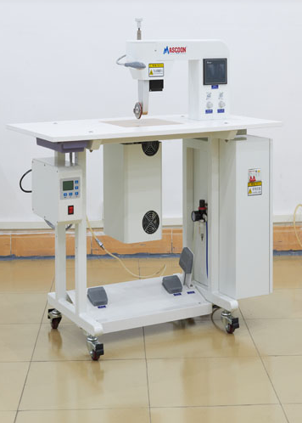
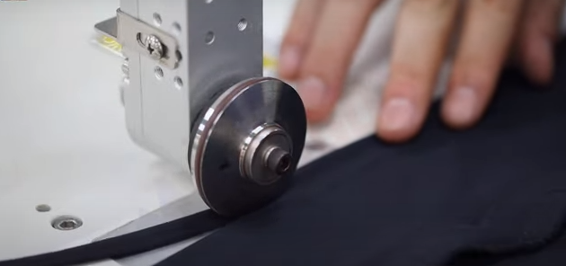
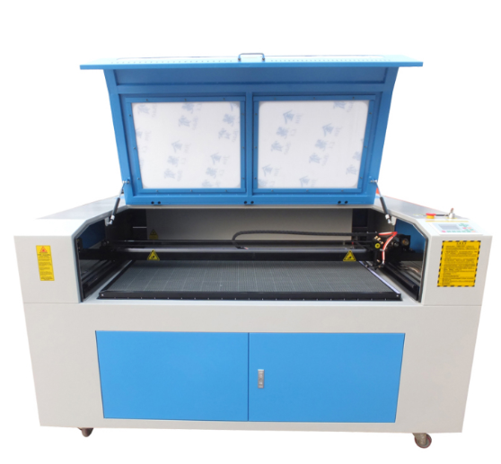
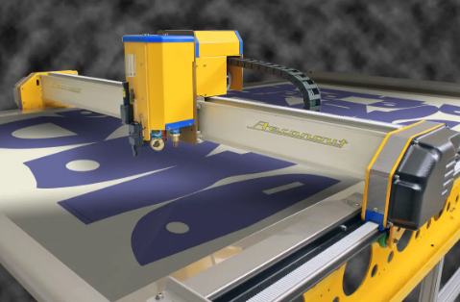
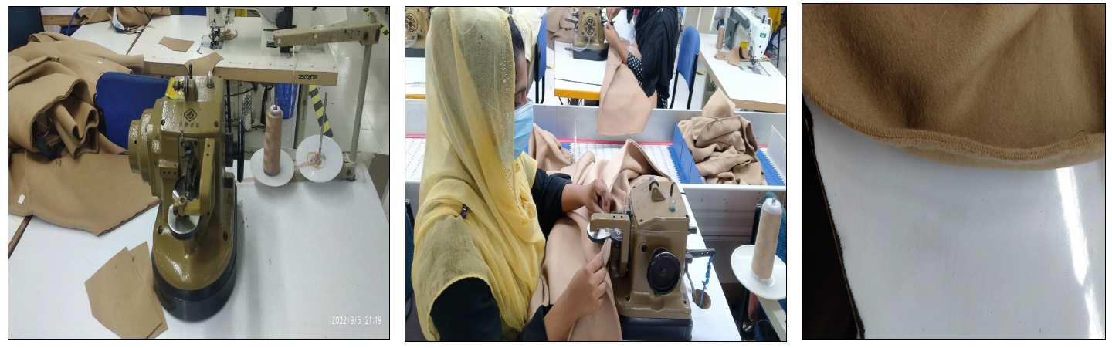
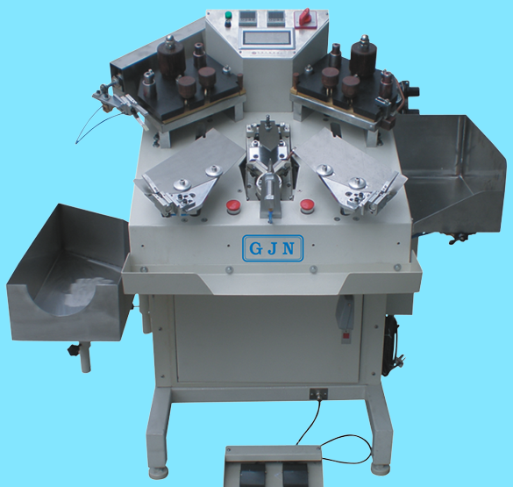
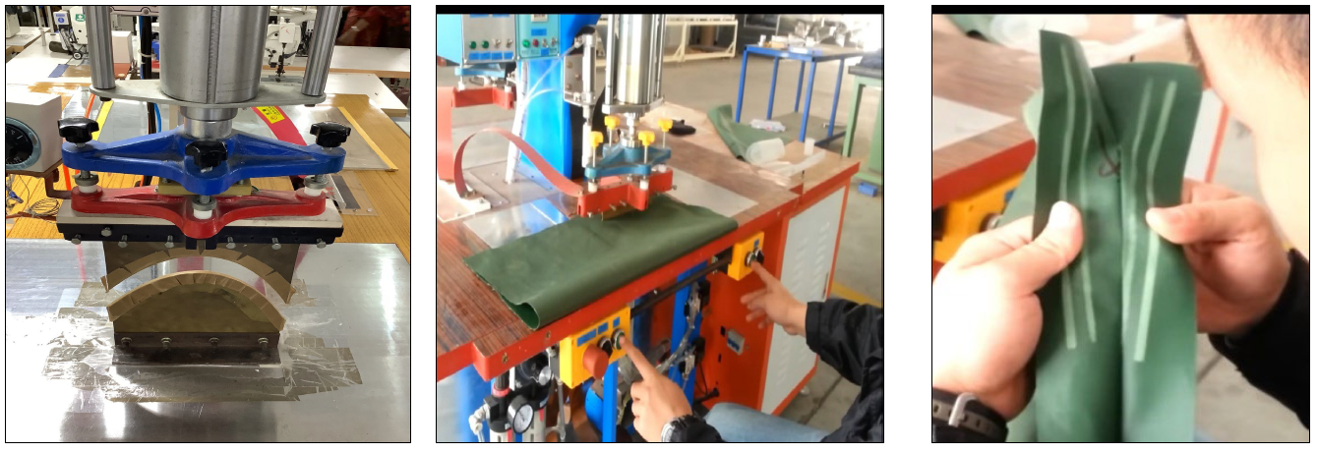
Latest machinery in Debonair:
Ultrasonic edge cutting
Laser cut Machine
High frequency Embossing Machine
Pleat stitch/Cover stitch Machine
APW Laser Machine
Hydrostatic sotter test (Water) tester machine auto/semi auto
Automatic Pocket Setter Machine
Loop Setter Machine
Automatic Collar trimming & Corner press Machine
High frequency Embossing Machine
Real down Filling Machine
Auto Fake Down Crashing Machine
Heat Press Machine
Needle Smocking Kansai Machine
Velcro/Label Attaching Machine
Auto Template Sewing Machine
Template Design and Cutting Machine
Seam Sealing Machine
Heat Press Machine
Auto Cutting & Spreading Machine

Slide 14
Thank you!

